Slide 1
Reinforcement Learning & Lab3
Siyuan Wang
2019-05-08

Slide 2
Outline
Reinforcement Learning for Gomoku
RL for News Recommendation
RL for Text Generation
Lab3
Project3

Slide 3
Outline
Reinforcement Learning for Gomoku
RL for News Recommendation
RL for Text Generation
Lab3
Project3

Slide 4
Reinforcement Learning for Gomoku
Adaptive Dynamic Programming for Gomoku
ADP with MCTS for Gomoku
Notes:
自适应动态规划

Slide 5
Adaptive Dynamic Programming for Gomoku

Slide 6
ADP for Gomoku
Adaptive Dynamic Programming(ADP):
ADP used in Gomoku is trained by temporal difference learning (TDL)
Key idea of ADP
In TD learning, the action decision or value function can be described in continuous form, approximated by nonlinear function such as neural network
Dongbin Zhao, Zhen Zhang, and Yujie Dai.
Self-teaching adaptive dynamic programming for Gomoku.
Neurocomputing, 78(1):23–29, 2012.

Slide 7
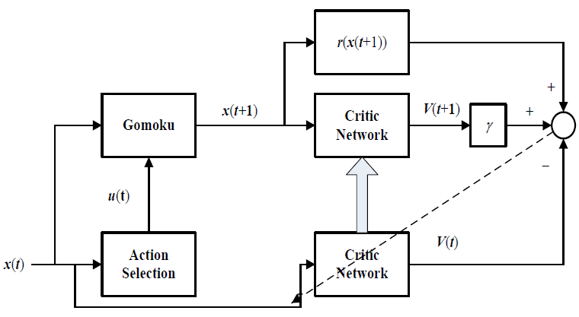
The ADP structure
x(t): current board state;
x(t+1): next step state;
The critic network is used to eatimate value function V(t)
u(t): action;
r(x(t+1)): reward;
Notes:
这个结构是从x(t)开始，At time t, x(t) is fed forward to the Action Selection模块中, x(t)描述的是the current board state， Action Selection针对棋盘的状态选取对应的action u(t). Under the action u(t), 游戏就会转移到下一个状态x(t+1), 同时得到一个reward r(x(t+1)).
在这个结构里面，我们还有一个ADP的核心思想，用Critic Network用来估计value function
Then the reward r(x(t+1)), the estimation V(t) and V(t+1) are used to 更新critic network的参数，使其(Value function)满足the Bellman equation.
接下里我们分别介绍这个结构里的内容和组件

Slide 8
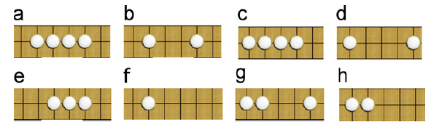
Board State x(t)
20 patterns for each of two players, totally 40 patterns
Whose turn to move
In the offensive/defensive(Who is first to move)
Notes:
先介绍一下Board state怎么构造
为了详细说明棋盘的情况，state中需要包含哪些内容
1. 定义了一些旗子出现的pattern，我们要记录这些pattern是否出现，以及出现了几次，我们总共定义了20种pattern（包括五个子连成一条线），这里列举了8种，我们需要对两个玩家分别记录pattern的状况，总共就是40种pattern
为什么定义pattern而不是raw info，是因为pattern更容易理解，且raw info的状态空间大得多
2. 要记录当前轮到谁下了
3. 要记录玩家的状态（防御还是进攻）

Slide 9
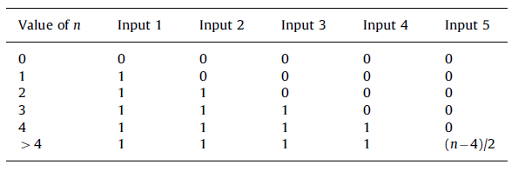
Board State x(t)
Five input nodes(dimensions of state) indicate the number of every pattern except for five-in-a-row (n: the number of a pattern)
The number of the special pattern five-in-a-row, is represented by 1 input node(dimension). If this pattern shows up, then its input is 1, otherwise 0
Notes:
要在state中用5维去记录每一个pattern出现的个数，除了五个连成一条线，因为这个时候游戏就结束了
这个表就是这五维如何表示一个pattern出现的次数n

Slide 10
Board State x(t)
For each pattern we assign two input nodes(dimensions) to represent the turn
Use two input nodes(dimensions) to indicate which player is the first to move
Totally 19*5*2+1*1*2+40*2+2 = 274 input nodes(dimensions)
Notes:
Player1下的话，就是1,0，反之就是0,1
为什么每个pattern都2个node：对于不同的pattern轮到谁走影响不同，如前一页的e
State最终由274维

Slide 11
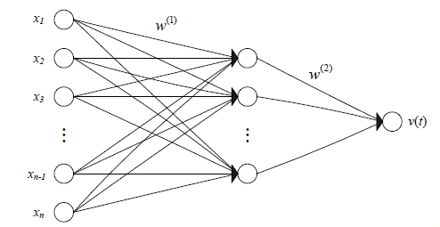
Critical Network(Value function)
Used to evaluate board situations(winning probability of player1)
A feed forward three-layer fully connected neural network
Unnecessary to be neural network, you can try other functions
Notes:
介绍完board state， 我们介绍一下critic是如何根据x(t)计算value值的
Input：就是size:274的state
Hidden size:100
最后的v(t)就是当前棋盘的评分(player1的胜率)

Slide 12


Critical Network(Value function)
Train the neural network
Define the prediction error
To minimize the objective error
Notes:
按照TDL方式定义error
这里的r(t+1)实际上就是t时刻采取的动作得到的reward
alpha is the learning rate and gamma is the discount factor

Slide 13
Reward
The reward is set to 0 during the game.
After a game, if player 1 wins, the final reward is 1, if he loses, the reward is 0, and if he draws, the reward is 0.5.
Notes:
Draws比较少发生，另一篇中draw也是0

Slide 14
Action Selection
Player 1 chooses the move that leads to the state with the maximal output value obtained from the critic network.
Player 2 selects the move that leads to the state with the minimal output value obtained by the same critic network.
Notes:
由于critic network得到的是player1的胜率

Slide 15
Action Selection
Reduce the action space
Only considering the empty positions near the ones occupied
When there are several alternative actions which have equally high evaluation, we simply choose the one that is last found
Notes:
a good move is often near a position which has been occupied.
第二个相当于随机选

Slide 16
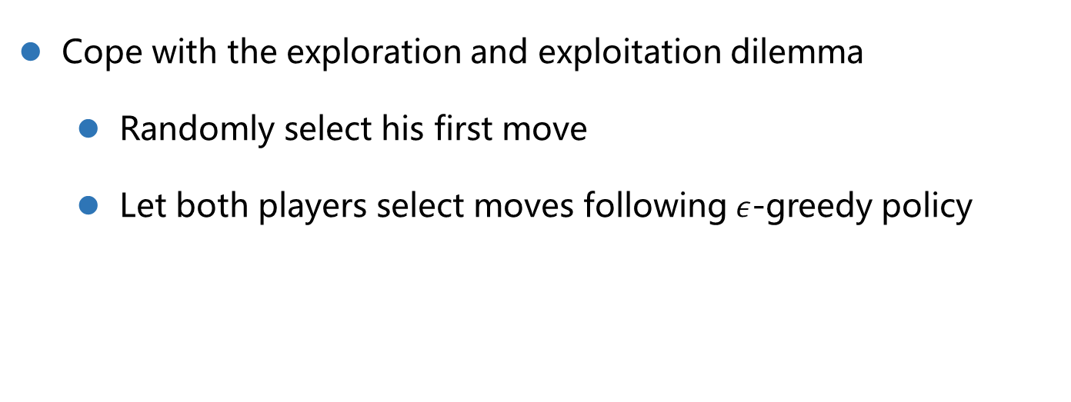
Action Selection
Cope with the exploration and exploitation dilemma
Randomly select his first move
Let both players select moves following $ε$-greedy policy
Notes:
Take action时增加随机性，至此整个ADP结构介绍完了
.

Slide 17
The ADP structure
Notes:
这个结构是从x(t)开始，At time t, x(t) is fed forward to the Action Selection模块中, x(t)描述的是the current board state， Action Selection针对棋盘的状态选取对应的action u(t). Under the action u(t), 游戏就会转移到下一个状态x(t+1), 同时得到一个reward r(x(t+1)).
在这个结构里面，我们还有一个ADP的核心思想，用Critic Network用来估计value function
Then the reward r(x(t+1)), the estimation V(t) and V(t+1) are used to 更新critic network的参数，使其(Value function)满足the Bellman equation.
接下里我们分别介绍这个结构里的内容和组件

Slide 18

Self-teaching
Playing against itself
On a platform called Pisvorky
Both player1 and player2 use the same critic network
ST-Gomoku
Notes:
这也是为什么可以前述take action

Slide 19
ADP with MCTS for Gomoku

Slide 20
ADP with MCTS for Gomoku
Monte Carlo Tree Search(MCTS)
The Basic process of MCTS
HMCTS
UCT
ADP with MCTS
Zhentao Tang, Dongbin Zhao, Kun Shao, and Le Lv.
ADP with MCTS algorithm for Gomoku.
2016 IEEE Symp. Ser. Comput. Intell. SSCI 2016, (61273136), 2017.
Notes:
我们先介绍一下MCTS的基本过程，再介绍五子棋中用的两种MCTS
然后再结合ADP和MCTS

Slide 21
MCTS
Requires a large number of simulation and builds up a large search tree according to the results.
The estimated value will be more accurate with the increase of the simulation times and nodes accessed.

Slide 22
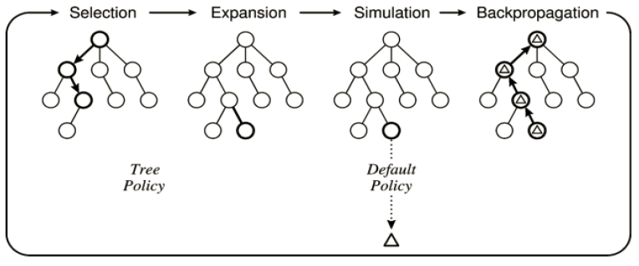
The Basic process of MCTS
Notes:
选到一个most urgent to expand的node(例如没有visit过得节点)，然后expand他的子节点（没有走过的）
之后从这个节点开始simulation到terminal，得到reward， 然后回传（将root node到expand node）遍历次数和总的reward更新

Slide 23
HMCTS
Heuristic Monte Carlo Tree Search
Apply Heuristic Knowledge in Simulation Policy

Slide 24
HMCTS
Heuristic rules
If four-in-a-row is occurred in my side, emerge five-in-a-row in my side.
If four-in-a-row is occurred in opposite side, block five-in-a-row in opposite side.
If three-in-a-row is occurred in my side, emerge four-in-a-row in my side.
If three-in-a-row is occurred in opposite side, block four-in-a-row in opposite side.

Slide 25
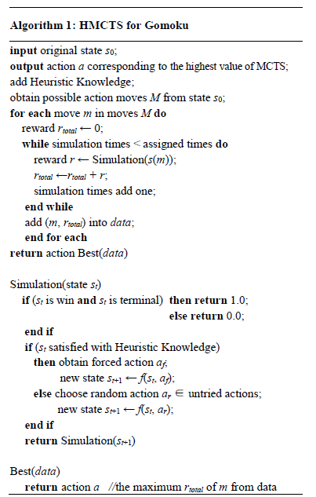
Goal
HMCTS
Save more time in simulation
than random sampling and get
converge earlier
Notes:
这个和前面的MCTS基本过程不太一样
对于每一个可能的动作得到的s(m)，都做同样次数的simulation，得到这个action m对应的的total reward，记录下来
最后选total reward最高的action，

Slide 26
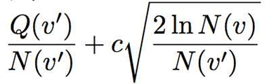

UCT
Upper Confidence bounds for Tree
Based on Upper Confidence Bounds(UCB)
Balance the conflict between exploration and exploitation and find out the final result earlier
is the average reward of node $v^{′}$, $N(v^{′})$ and $N(v)$is the visited count of node $v^{′}$ and $v$, $v$ is the parent of $v^{′}$
Exploitation
Exploration
Notes:
有两个节点，v是v’的父亲结点
total simulation reward Q(v), $N(v)$is overall number
encourages the exploitation of higher reward selection
encourages the exploration of less visited choices

Slide 27
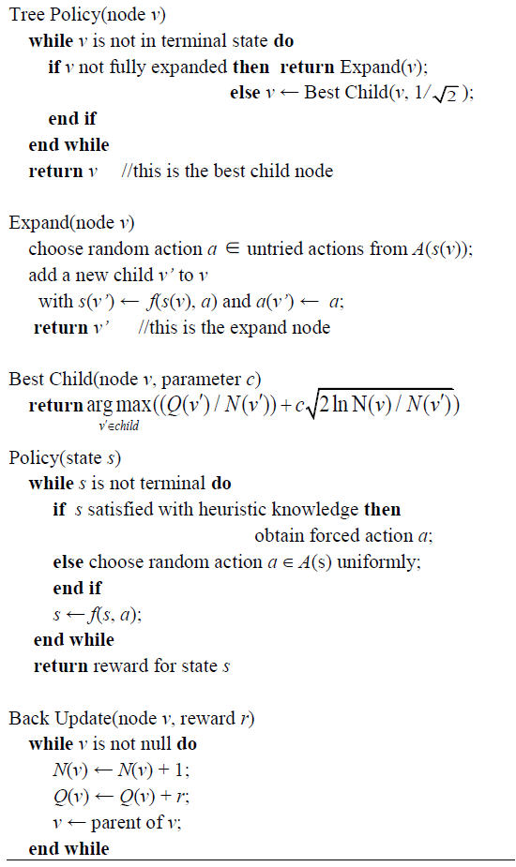
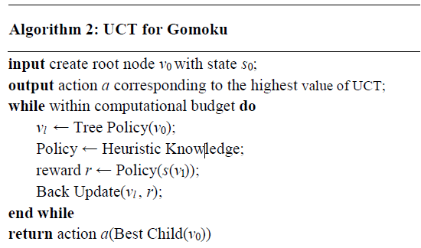
UCT
Goal
Notes:
这个和基本的MCTS比较相似
Tree Policy包含了selection和expansion， Policy是simulation，最后Back
首先Tree policy， 优先考虑没有探索过的节点，如果都探索过，取UCT分数最高的节点，向下找，然后扩展
Policy是simulation，和前一个HMCTS一样，最后回传
很多次迭代后，Best Child也用UCT选取最优action

Slide 28
UCT vs HMCTS
Can help to find out the suitable leaf nodes earlier.
Can save more time than HMCTS.
Notes:
number of simulation

Slide 29

ADP with MCTS
Use ADP to train critic network, get top-5 candidate moves and their ADP winning probabilities
Take each of candidate moves as the root node of MCTS and simulate, get their MCTS winning probabilities
Calculate the weighted sum of two winning probabilities:
Notes:
上面都是单纯的MCTS，但是MCTS的时间复杂度太高，spend a lot of time on searching some unnecessary feasible actions
Compared with only using MCTS, it should save a large amount of time to find out the suitable action for Gomoku

Slide 30
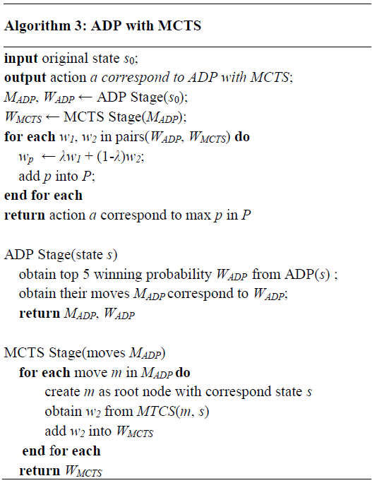
ADP with MCTS
ADP: ST-Gomoku
Notes:
不详细讲了

Slide 31
ADP with MCTS
Compared to ADP :
Eliminate the neural network evaluation function's “short sight” defect, ensure the accuracy of the search
Compared to MCTS :
Save a large amount of time to find out the suitable action for Gomoku
Notes:
解决了ADP的short-sight of network evaluation问题, 根据current state, 只能根据当前的reward来训练 ->MC simulations(每一步都能往后看)

Slide 32
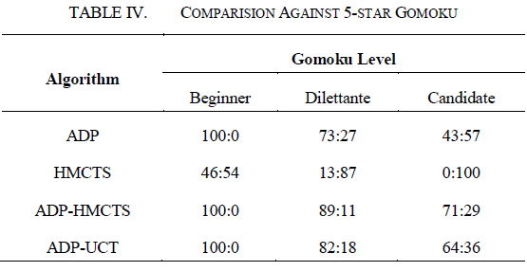
ADP with MCTS
Experimental Results

Slide 33
Outline
Reinforcement Learning for Gomoku
RL for News Recommendation
RL for Text Generation
Lab3
Project3

Slide 34
RL for News Recommendation
Try to solve the online personalized news recommendation problem.
Zheng G, Zhang F, Zheng Z, et al.
DRN: A Deep Reinforcement Learning Framework for News Recommendation.
International World Wide Web Conferences Steering Committee, 2018: 167-176.

Slide 35
Challenges in news recommendation
The dynamic changes in news recommendations are difficult to handle.
Current recommendation methods usually only consider the click / no click labels or ratings as users’feedback.
It tend to keep recommending similar items to users, which might decrease users’ interest in similar topics.
Notes:
1. news become outdated very fast; users’ interest on different news might evolve during time
Only try to optimize the current reward, ignore effect in the future.
2. how soon one user will return to this service, indicate how satisfied this user is with the recommendation
3. add some randomness, ϵ-greedy strategy or Upper Confidence Bound (UCB), but harm the recommendation performance to some extent(unrelated items, can not get a relatively accurate reward estimation until this item has been tried several times.)

Slide 36
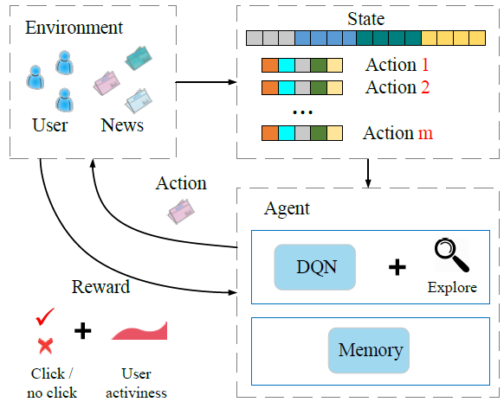
Deep reinforcement recommendation system
Notes:
Environment和agent交互，user pool and news pool make up the environment， agent: our 推荐系统
Each time when a user requests for news, user作为state，and a set of news作为actions 传递给agent，The agent will select the best action and fetch user feedback as reward.

Slide 37
Deep reinforcement recommendation system
State: features of a user
Action: a piece of news
Reward: click/no click label + user activiness
DQN
Explore: Dueling Bandit Gradient Descent method
Notes:
Formulate成RL中MDP形式
DQN: 可以通过估计Q-value(之后的点击概率)考虑到未来reward（动态性）

Slide 38



Deep reinforcement recommendation system
User Activeness
User return time to the application
Survival models
The hazard function
The probability for the event to happen after t (activeness score)
Every time we detect a return of user：
Notes:
就是使用一个survival model根据用户的点击状况计算activeness.不详细讲，感兴趣可以看
T is the time until next event (i.e., user return) happens
Lambda设为常量
Score不会超过1
S0 is set to 0.5（represent the random initial state of a user）， T0 to 24 hours， λ0 is setto 1.2 × 10−5， Sa=0.32

Slide 39
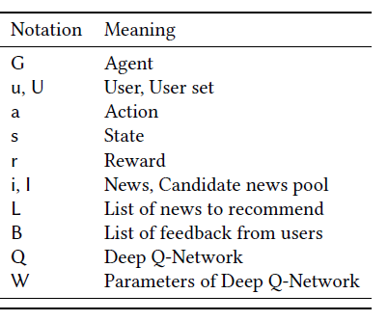
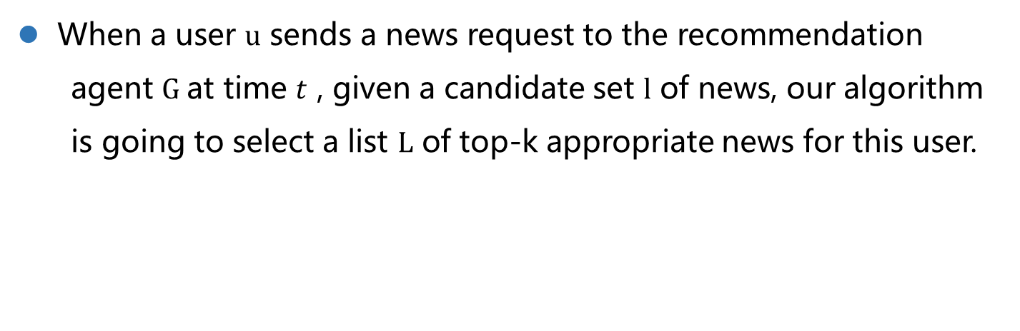
Problem Definition
When a user $u$ sends a news request to the recommendation
agent $G$at time $t$ , given a candidate set $l$ of news, our algorithm is going to select a list $L$ of top-k appropriate news for this user.

Slide 40
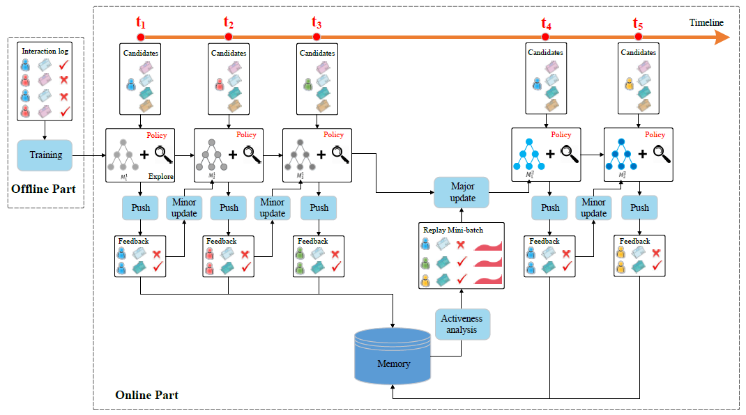
Model framework
Offine part + Online part
Notes:
composed of offline part and online part.
Offine part，使用用户和系统的interaction logs去训练一个DQN，online就是根据在线交互去更新模型

Slide 41
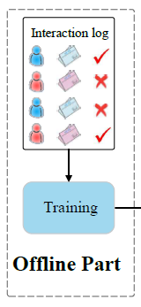
Offline part
This network is trained using the offline user-news click logs.
Take features extracted from news and users as input.
Train a multi-layer Deep Q-Network to predict the Q-value (probability that a user may click on a piece of news).
Notes:
根据user-news click label and user activeness

Slide 42
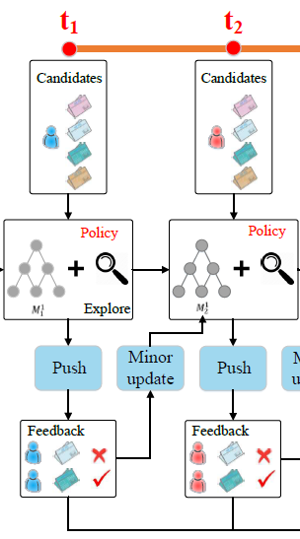
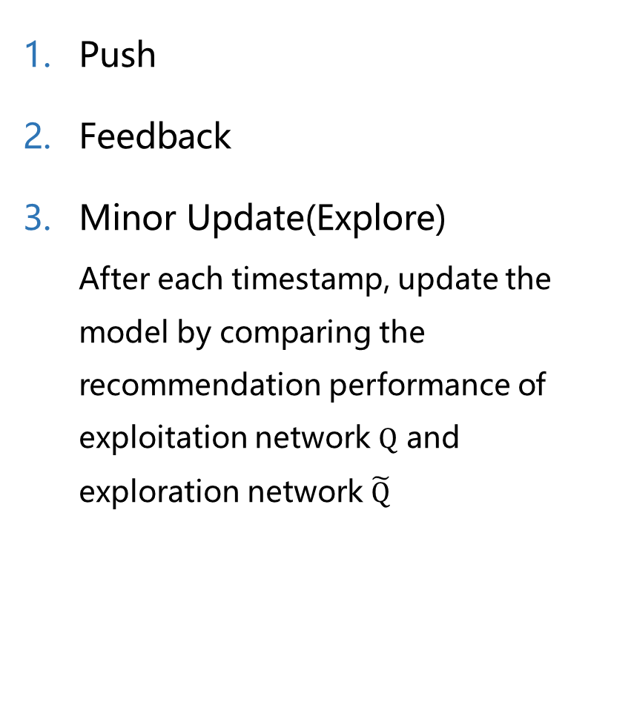
Online part
Push
Feedback
Minor Update(Explore)
After each timestamp, update the model by comparing the recommendation performance of exploitation network $Q$ and exploration network $\tilde{Q}$
Notes:
In each timestamp, when a user sends a news request to the system, agent G 将user and news candidates作为 input, and generate a top-k list of news to recommend L.
User u 得到推荐的新闻L will give their feedback B by his clicks on this set of news.
第三步只是explore，真正的参数迭代在第四步

Slide 43

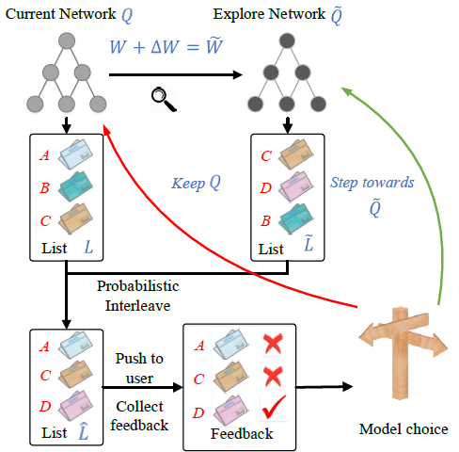

Minor Update(Explore)
Dueling Bandit Gradient Descent algorithm
Probability interleave
Obtain feedback
Decide to update
Notes:
α is the explore coefficient
如果来自explore Net的结果更好，就更新成Explore

Slide 44
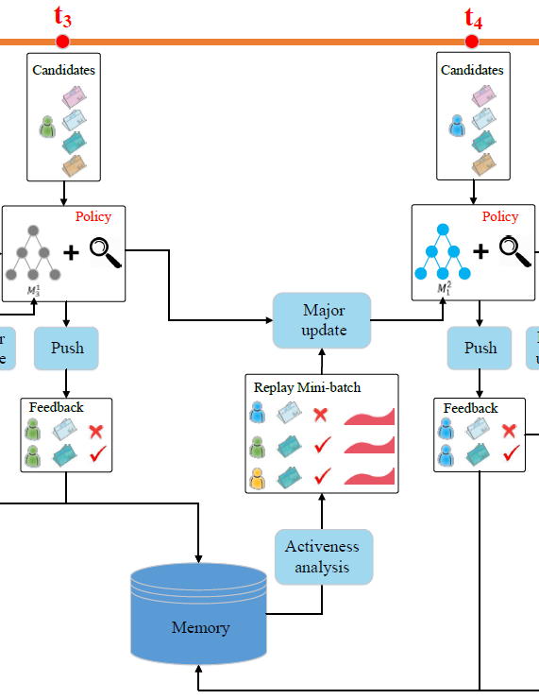
Online part
Major Update
After certain period of time(e.g. one hour), use the user feedback B and user activeness stored in the memory to update the network Q
Notes:
Experience Replay： 去除样本相关性

Slide 45
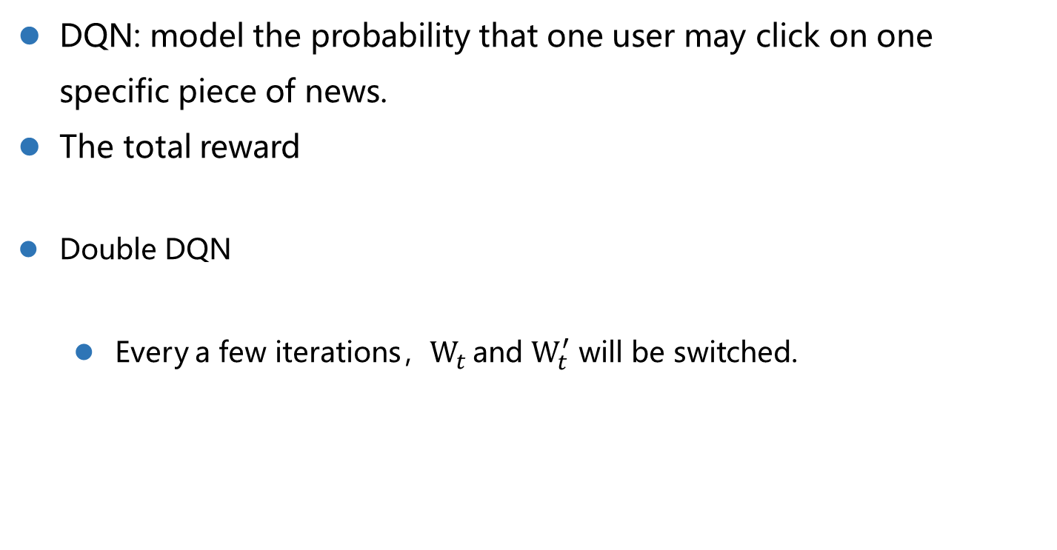
Major Update
DQN: model the probability that one user may click on one specific piece of news.
The total reward
Double DQN
Every a few iterations，$W_{t}$ and $W_{t}^{′}$ will be switched.
Notes:
具体怎么更新
Total reward：当前的reward+后面很多轮的reward， 后面的都可以看作future reward，形式显示了DQN可以model future reward
当前开始总回报：当前即时奖励和下一个状态s′ 的值函数
Immediate reward：
DQN中选动作和估计Q值使用相同的参数，会导致optimal Q-value估计过高，所以要对选择和衡量解耦（Double DQN，使用不同的参数，类似参数冰冻中的参数,或者switch）

Slide 46
Model framework
Offine part + Online part
Notes:
整个online，就包含这四个步骤，一直迭代

Slide 47
Outline
Reinforcement Learning for Gomoku
RL for News Recommendation
RL for Text Generation
Lab3
Project3

Slide 48
RL for Image Captioning
Try to apply RL to image captioning to directly optimize non-differential task metrics rather than cross entropy loss.
Steven J. Rennie1, Etienne Marcheret1, Youssef Mroueh, et al.
Self-critical Sequence Training for Image Captioning.
Proceedings of the IEEE Conference on Computer Vision and Pattern Recognition. 2017: 7008-7024.
Notes:
以Image Captioning为例

Slide 49
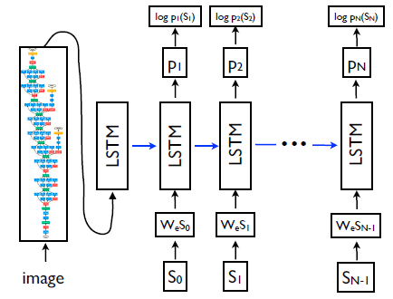

Text Generation as an RL problem
Agent: the neural model
Environment: images and words
State: the internal state of model (cells and hidden states of the LSTM, …)
Action: predict the next word
Policy $p_{θ}$: defined by the parameters of the network $θ$
Reward $r$: the metrics score(CIDEr, BLEU) of the generated sentence
Notes:
An agent interact with an external environment
Policy: 由参数定义的生成概率P
LSTM中每一步都会更新state， 对应After each action, the agent (the LSTM) updates its internal “state”， 并且会得到一个reward
但是text generationg中不是每一步都有reward， 直到Upon generating the end-of-sequence (EOS) token,
Reward是通过和ground-truth的text对比生成

Slide 50

Text Generation as an RL problem
Goal of training: minimizing the negative expected reward
Notes:
W_s就是一条轨迹，就是a generated sentence, （有每个时刻生成的tokens）

Slide 51

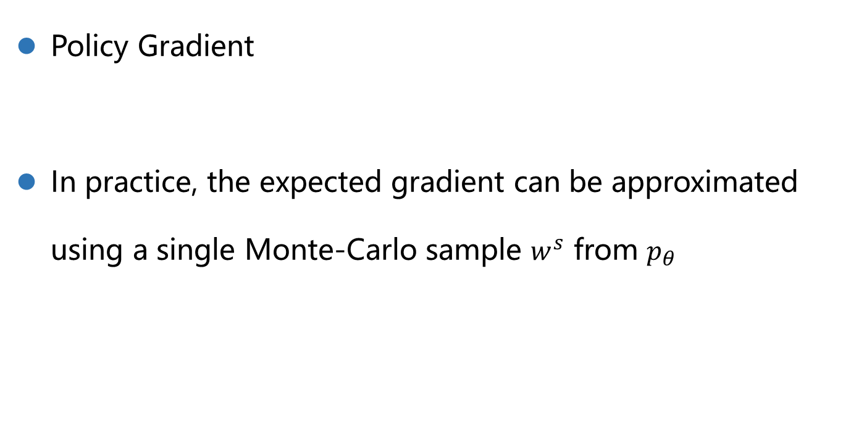
Policy Gradient
Policy Gradient
In practice, the expected gradient can be approximated using a single Monte-Carlo sample $w^{s}$ from $p_{θ}$
Notes:
通过MC sampling得到的observation去算Expectation，我们single sample
每次Update的时候我们只用一个sample

Slide 52
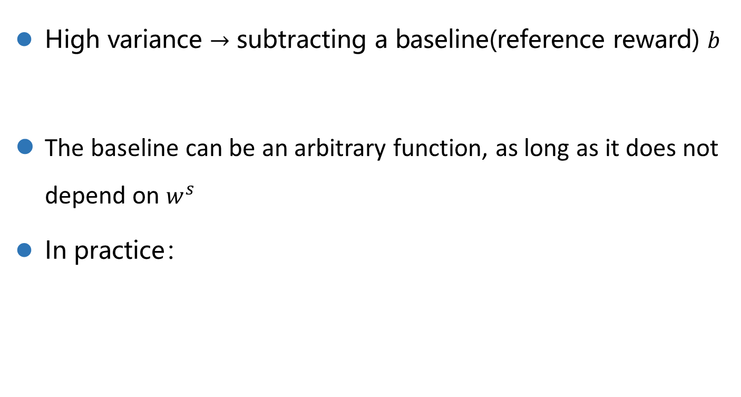
REINFORCE with a baseline
High variance $→$ subtracting a baseline(reference reward) $b$
The baseline can be an arbitrary function, as long as it does not depend on $w^{s}$
In practice：
Notes:
方差很大，训练不稳定
加一个baseline，相对原来和action相关的reward， 加一个reference reward
只要和由这个策略sample的轨迹无关， 关于theta和t的function也可以
只有满足这个条件，加上的的那部分梯度为0，对梯度没有影响，且可以降低方差, 为有效减小方差，b和reward越相关越好

Slide 53

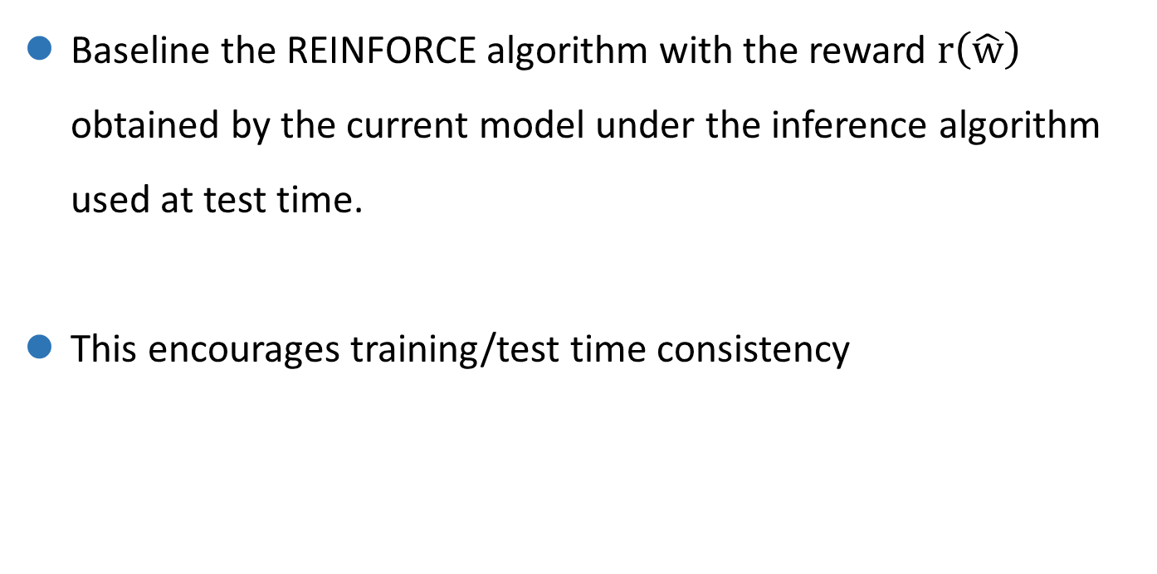
Self-critical sequence training(SCST)
Baseline the REINFORCE algorithm with the reward $r\left(\hat{w}\right)$ obtained by the current model under the inference algorithm used at test time.
This encourages training/test time consistency
Notes:
w_s是从policy中随机sample的，我们训练的模型在inference时每一步在policy(P)中argmax
如果当前sample到的词比测试阶段生成的词好，那么在这些词的维度上，整个式子的值就是负的（因为后面那一项一定为负），负梯度方向就是正的（上升），从而提高这个词的分数；
若差一些，前面是负的，后面也是负的， 整个是正的

Slide 54
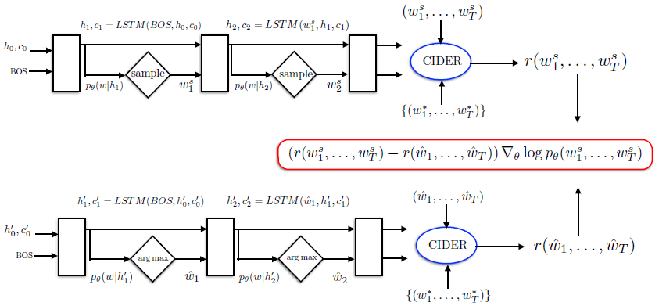
Self-critical sequence training(SCST)

Slide 55
Outline
Reinforcement Learning for Gomoku
RL for News Recommendation
RL for Text Generation
Lab3
Project3

Slide 56
Lab3
Problem:
Solve the Grid World Problem based on MDP
Requirement:
Print optimal value of all states using value iteration and policy iteration
Address: http://10.88.3.61/problem.php?cid=1003&pid=0

Slide 57
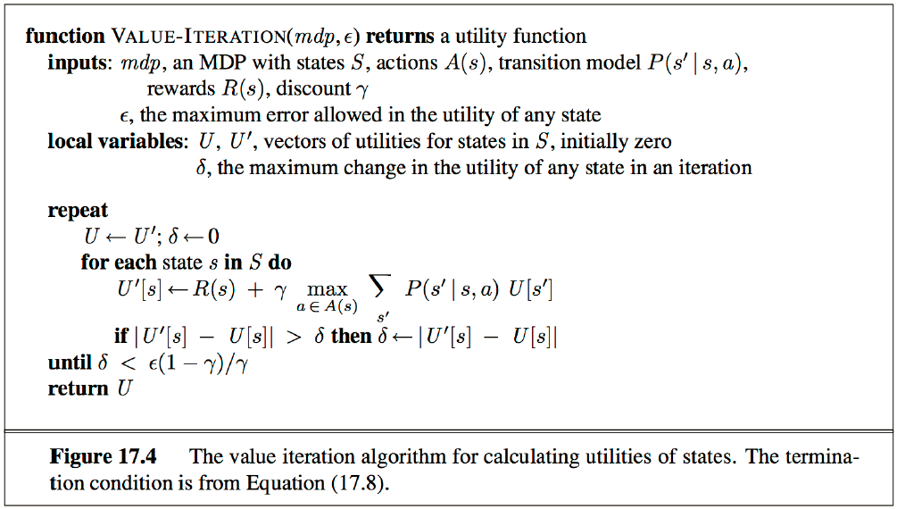
Lab3
Value Iteration

Slide 58
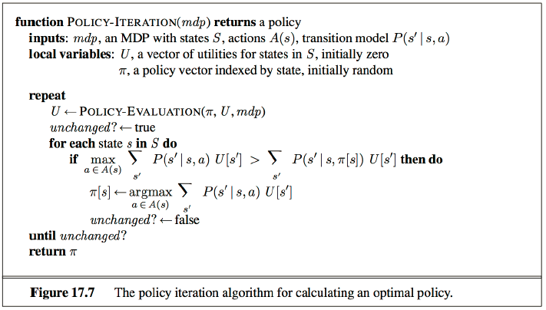
Lab3
Policy Iteration

Slide 59
Outline
Reinforcement Learning for Gomoku
RL for News Recommendation
RL for Text Generation
Lab3
Project3

Slide 60
Blackjack
A deck:
a standard deck would have card values [1,2,…,13] *4
In our version., the deck can contain an arbitrary collection of cards with different values, e.g. [1,5,20], [1,2,3]
Action：
takes the top card
peeks at the top card
quits the game
Notes:
有一副牌，被打乱的
The game occurs in a sequence of rounds， 每一个round， 可以采取三个动作

